Slide 1
SLiPaD
Smart Lighting with Parking Detection
Design
Embedded Systems
Group 9: Diogo Fernandes – A88262
José Tomás Abreu – A88218

Slide 2
Agenda
Recap
Network Architecture
System Overview
Hardware Architecture
Hardware Specification
Software Specification
Local System
Gateway
Remote System
Tools and COTS
GUIs

Slide 3
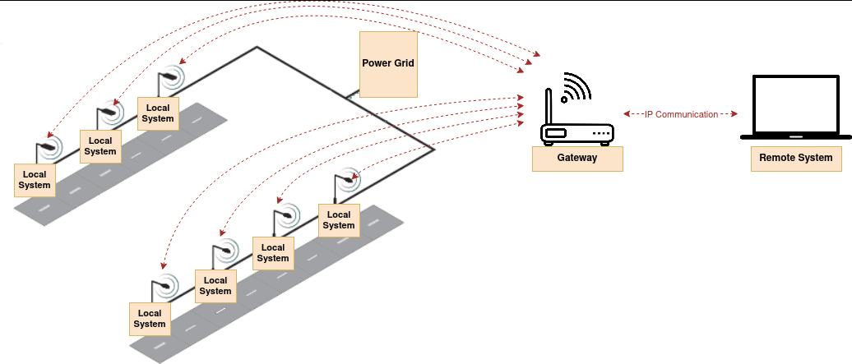
Network Architecture

Slide 4
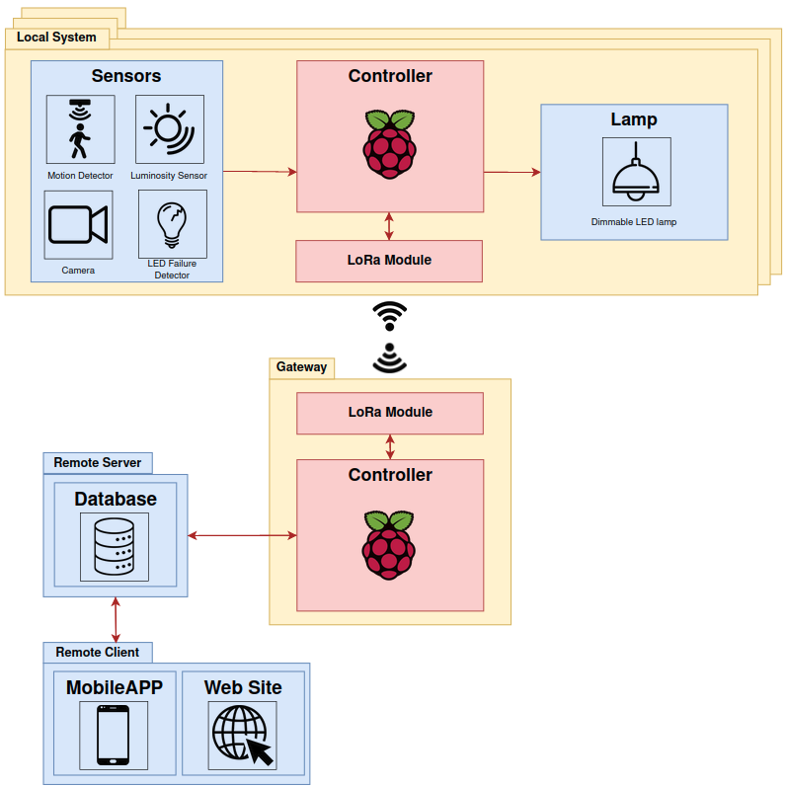
System Overview

Slide 5
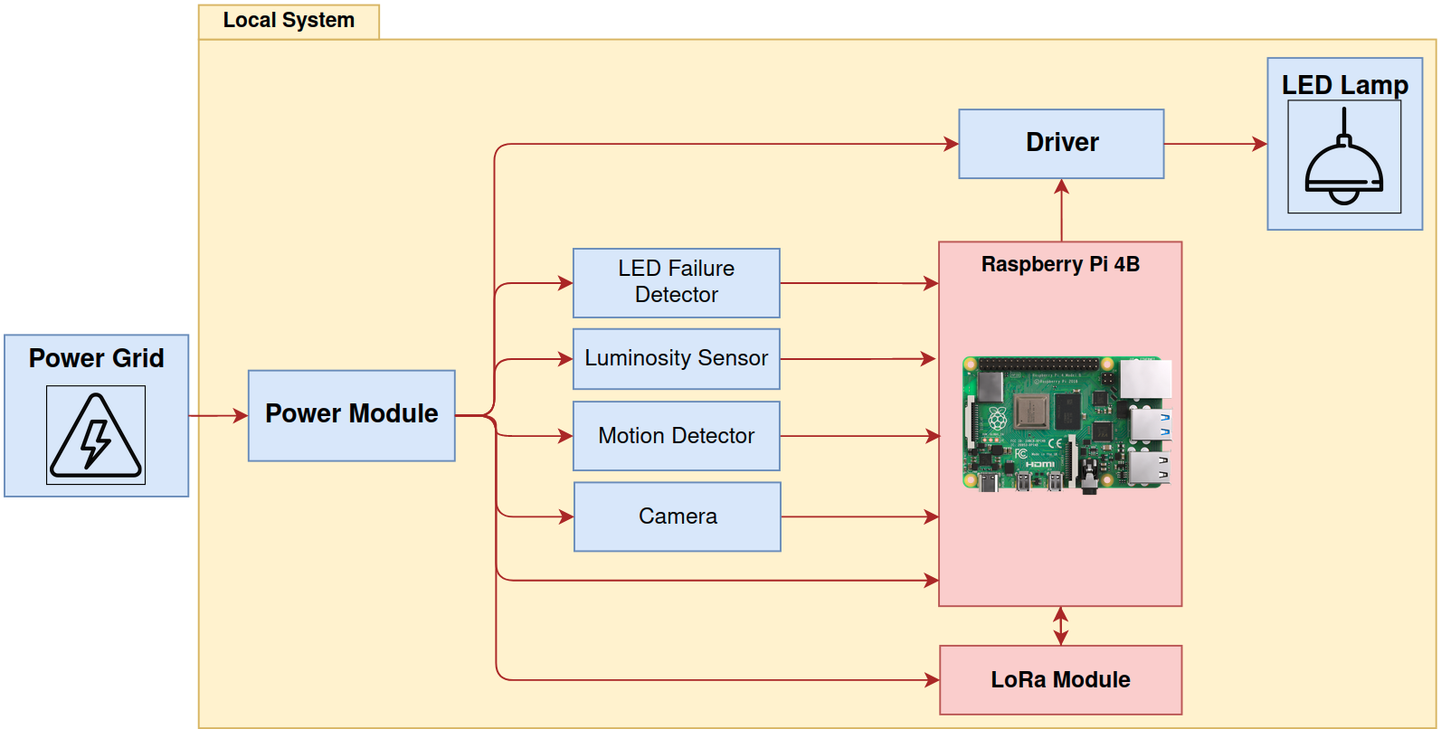
Hardware Architecture

Slide 6
Hardware Specification

Slide 7
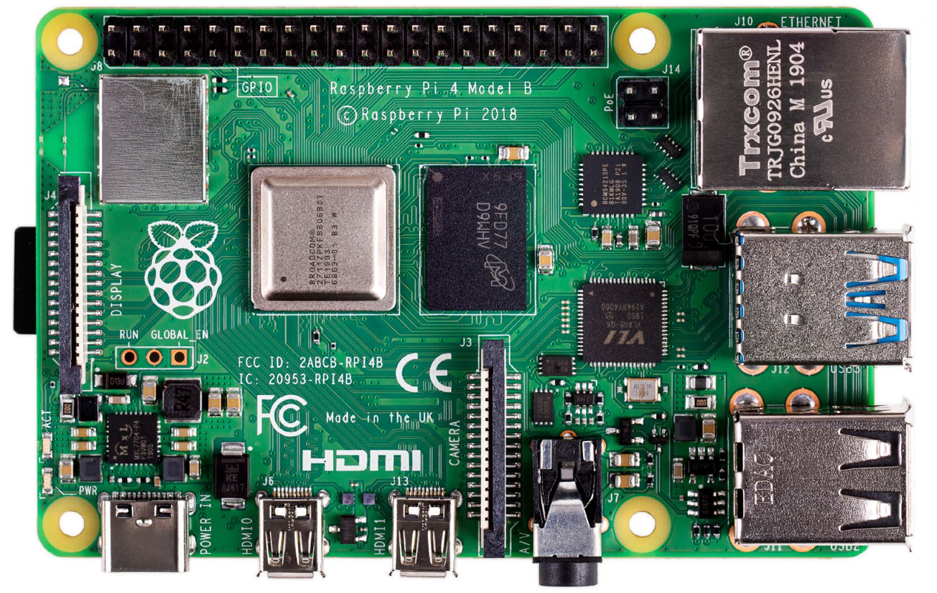
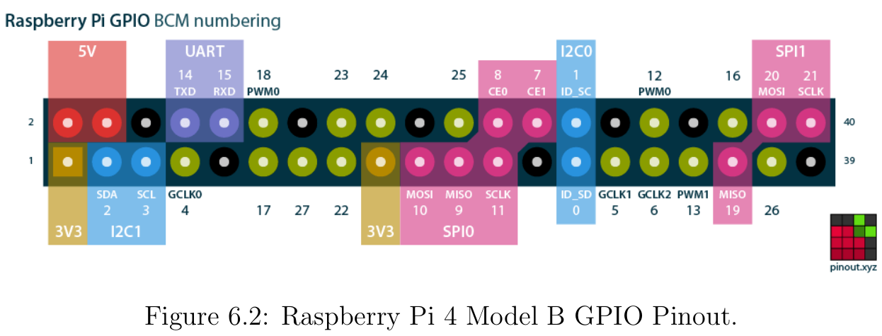
Development Board
BCM2711 Arm processor

Slide 8
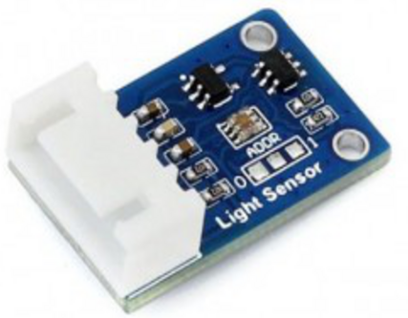
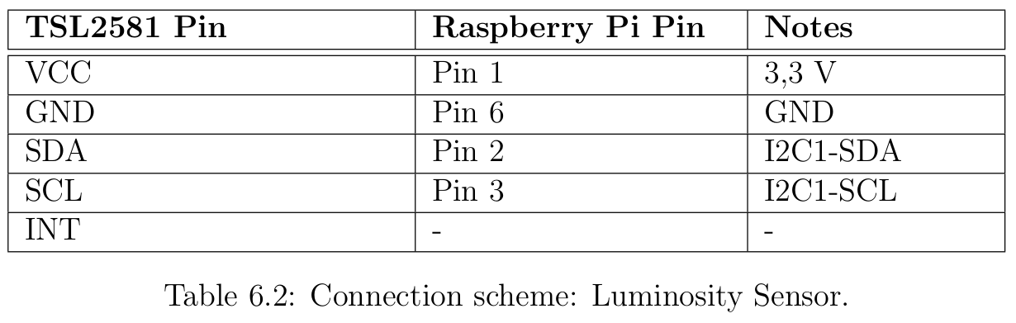
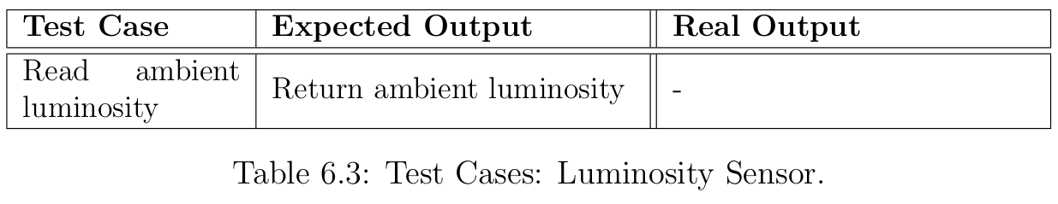
Luminosity Sensor - LDR TSL2581
I2C interface outputs the ambient light intensity value;

Slide 9
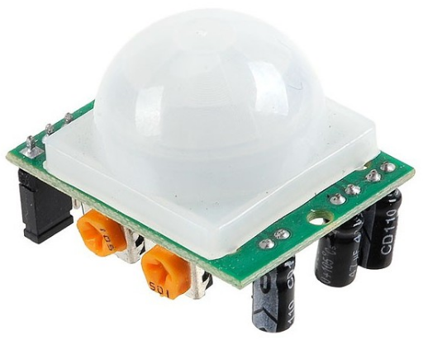
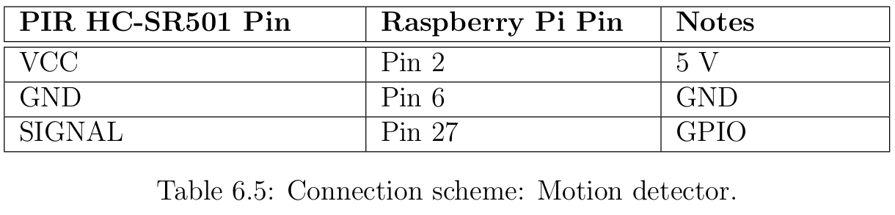
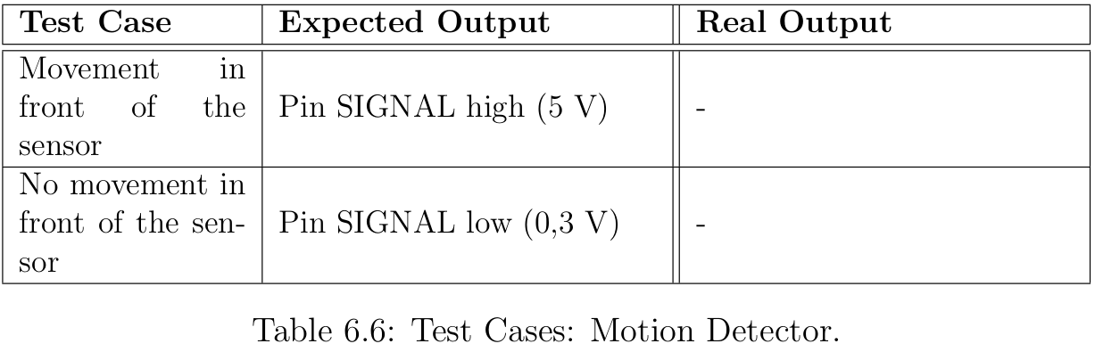
Motion Detector - PIR HC-SR501
Detection range of 7 meters;
Digital output signal;

Slide 10
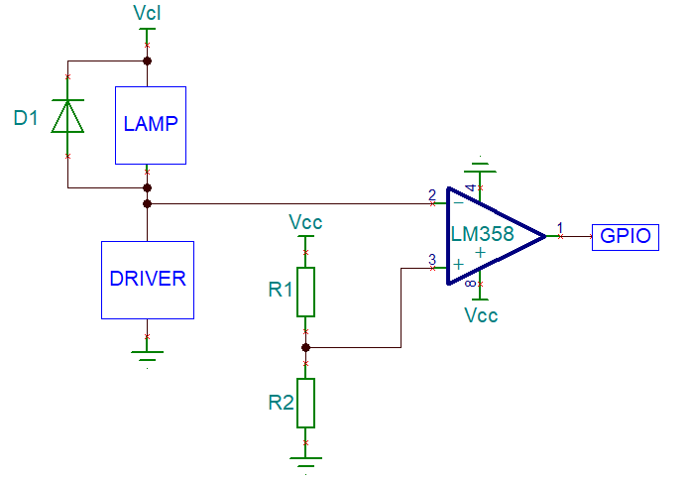
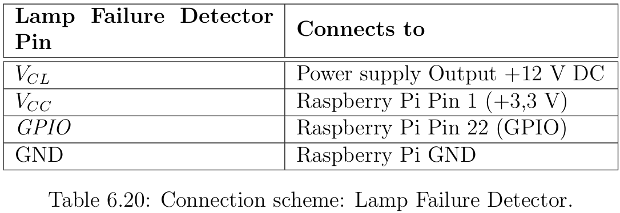
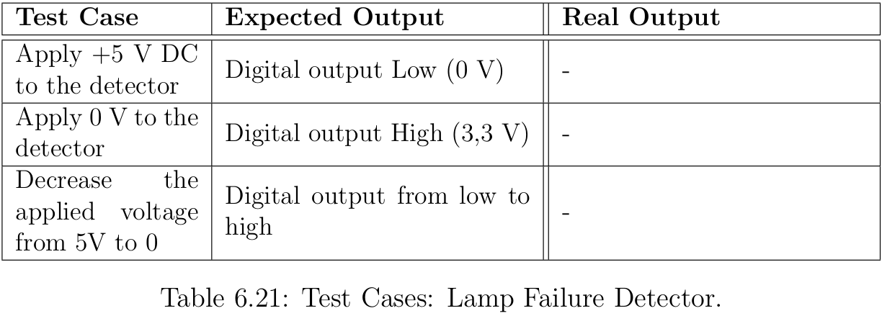
Lamp Failure Detector
Op-Amp: LM358
R1 = 2 kohm
R2 = 4,7 kohm

Slide 11
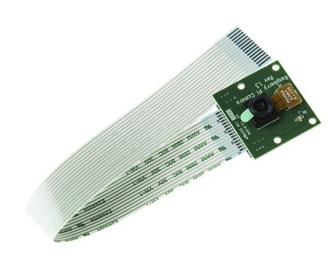
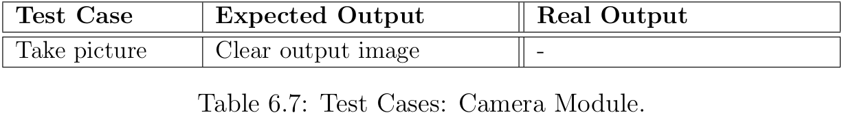
Raspberry Pi Camera Module V1
5MP OmniVision sensor;
15-pin ribbon cable to connect to CSI;

Slide 12
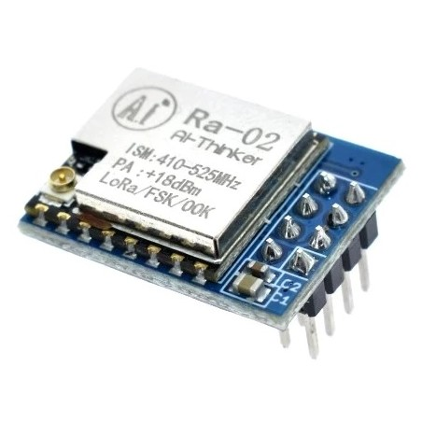
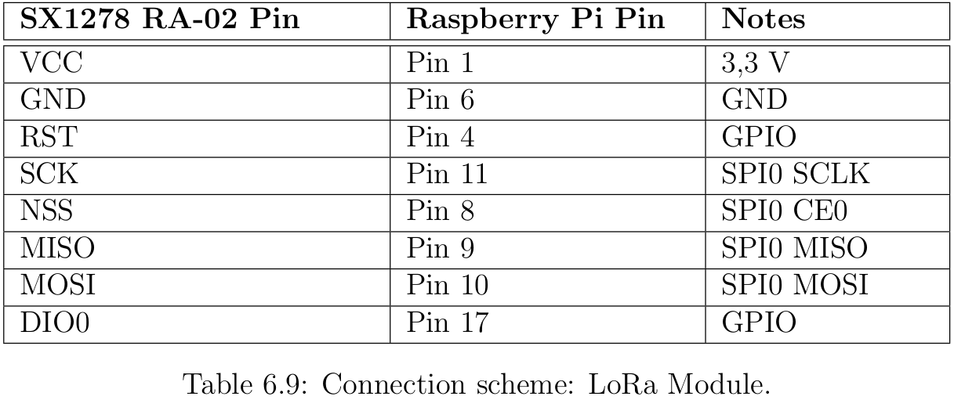
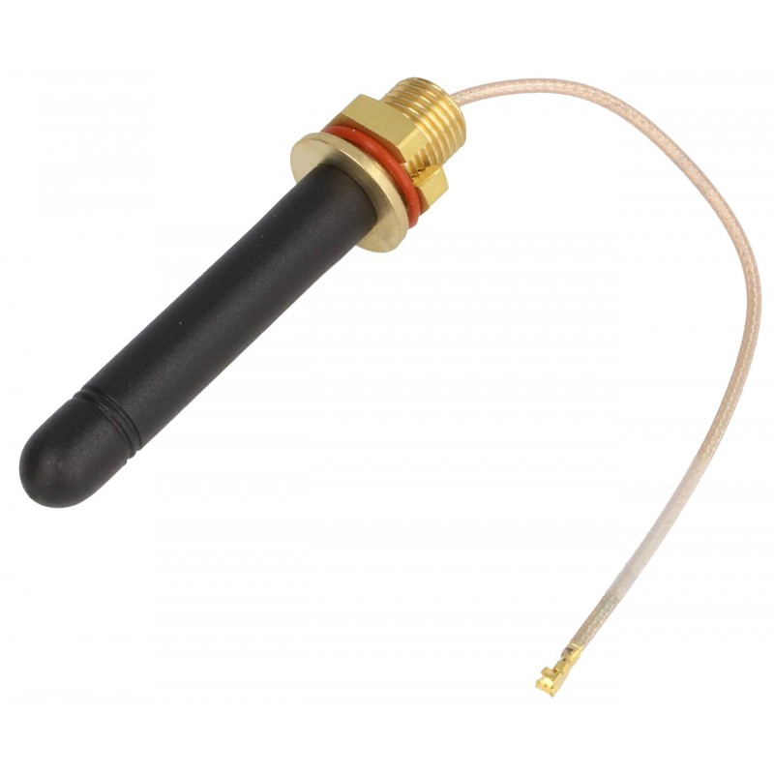
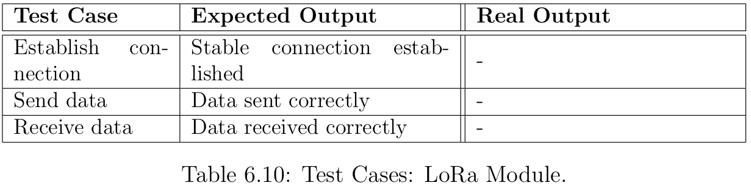
LoRa Module SX1278 433MHz
Half-duplex SPI communication;
Effective Bitrate : 0,018 - 37,5 kbps;

Slide 13
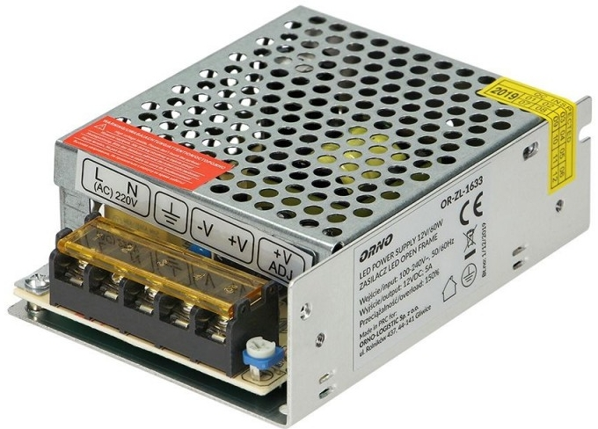
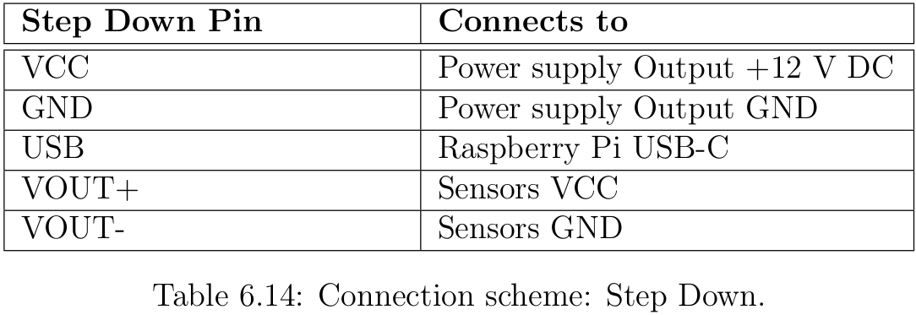
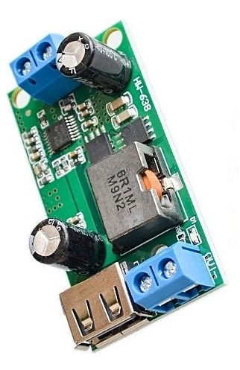
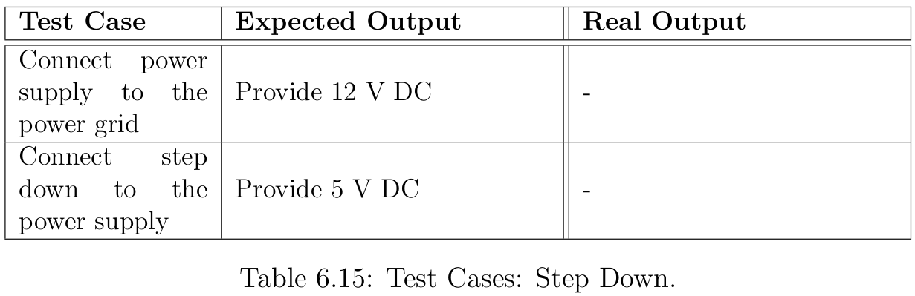
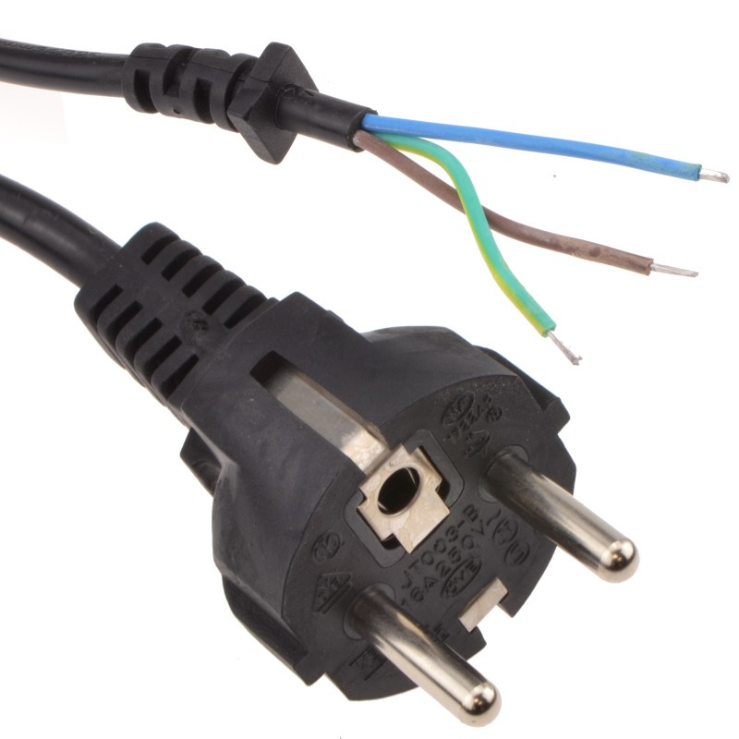
Power Module
Power supply output voltage: 12V/5A;
Step-Down output voltage 5 V / 5 A;

Slide 14
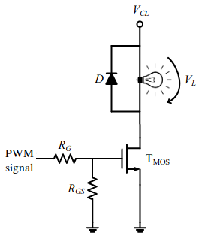
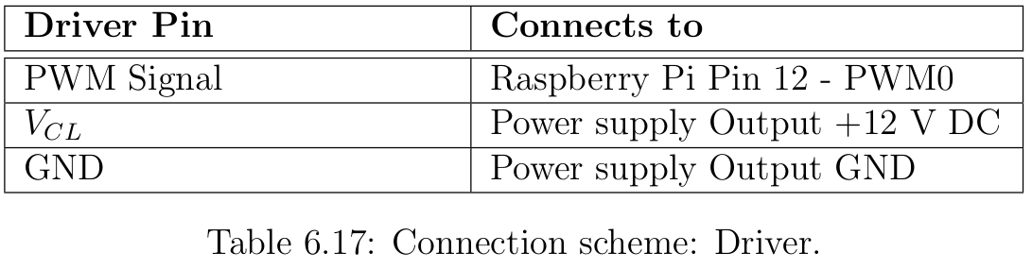
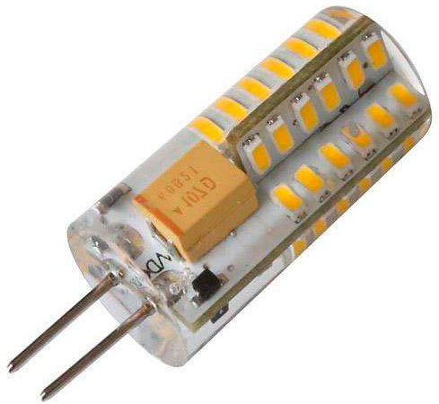
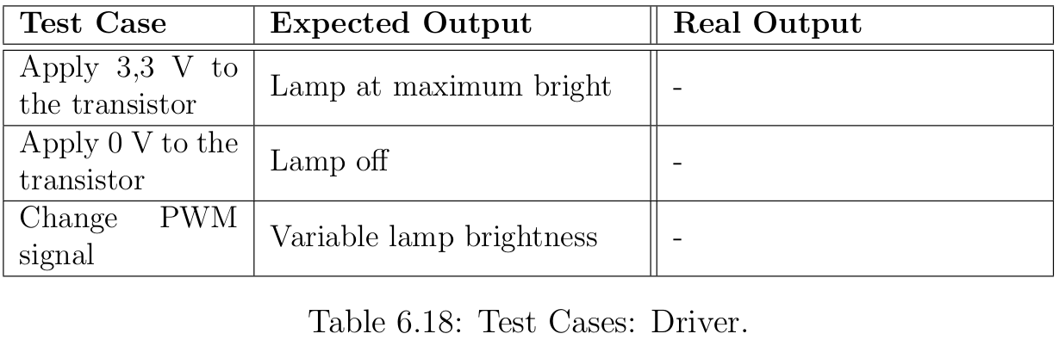
Driver and Lamp
TMOS: BUK453
Diode D: MR852
RG = 100 ohm
RGS = 12 kohm

Slide 15
Software Specification
Local System

Slide 16
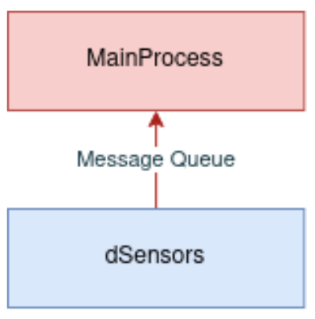
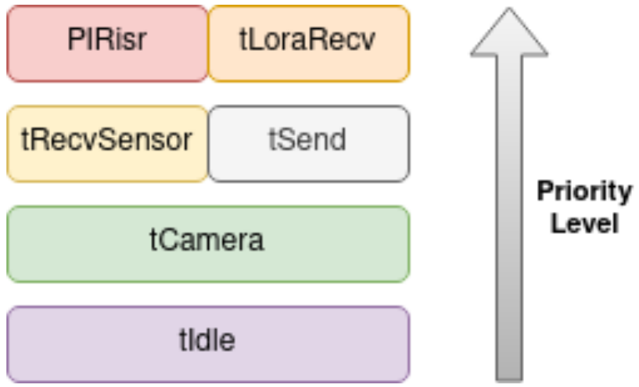
Task Overview
tCamera: acquire a camera frame, process image and search for parking spots;
tSend: sends a message to the gateway;
tLoraRecv: receives a message from the gateway;
tRecvSensor: receives sensors information, from the daemon;
PIRisr: turns-on the lamp when PIR is activated and sends it to the gateway.

Slide 17
Task Synchronization
condCameraAcquire: notifies tCamera that a camera sample period has elapsed;
condSend: notifies tLoraSend that a new message is ready to be sent;
mutCamera: associated with the condition variable condCameraAcquire;
mutSend: protects the message to be sent in tSend;
mutComms: protects LoRa communication;
mutChangePWM: protects the modification of PWM when defining a new PWM value for the lamp;

Slide 18
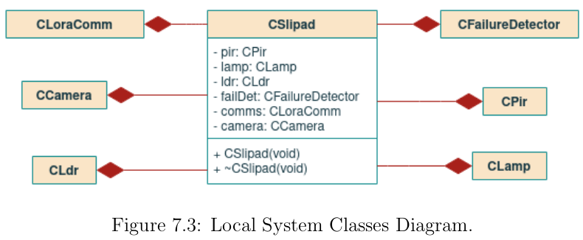
Classes Diagram

Slide 19
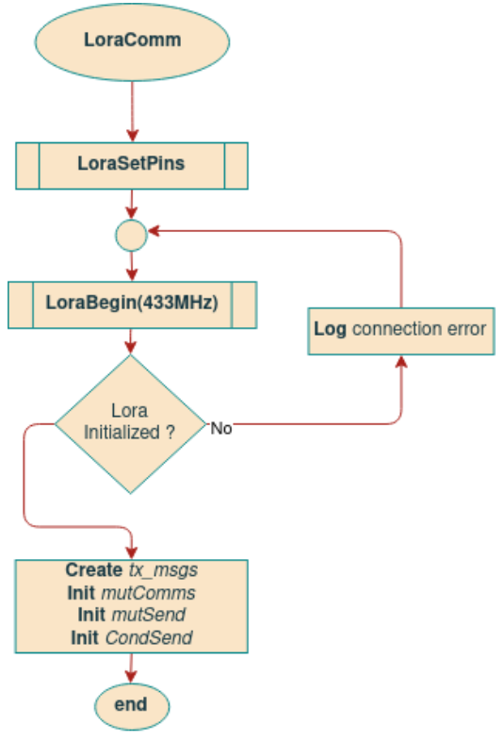
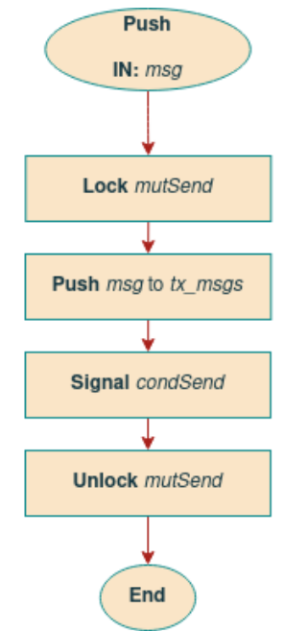
LoraComm - Flowcharts

Slide 20
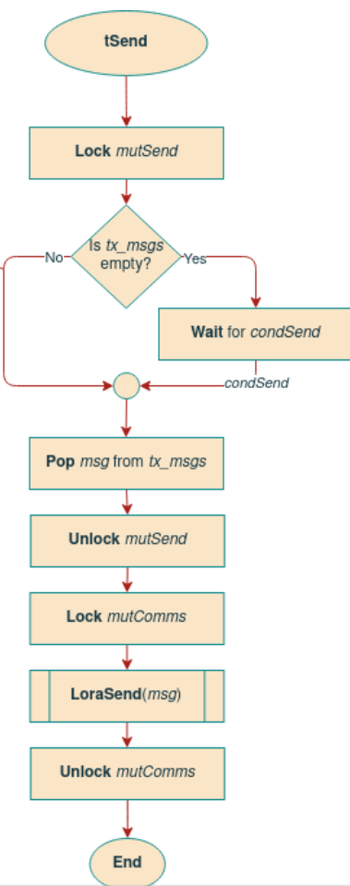
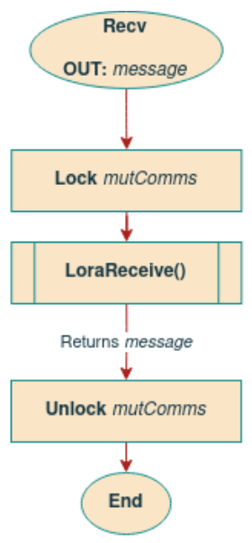
LoraComm - Flowcharts

Slide 21
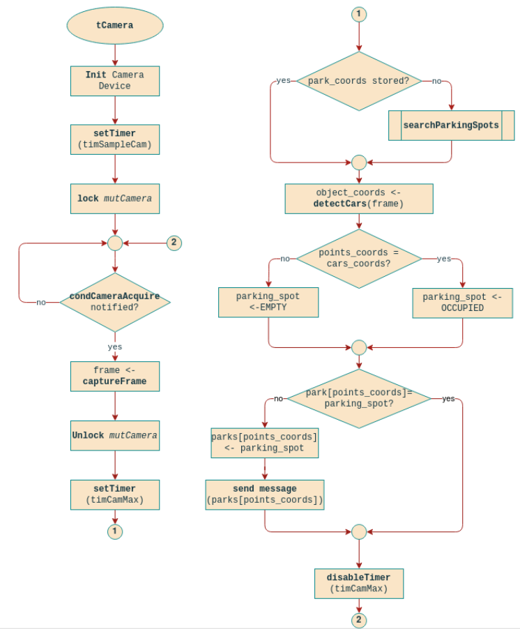
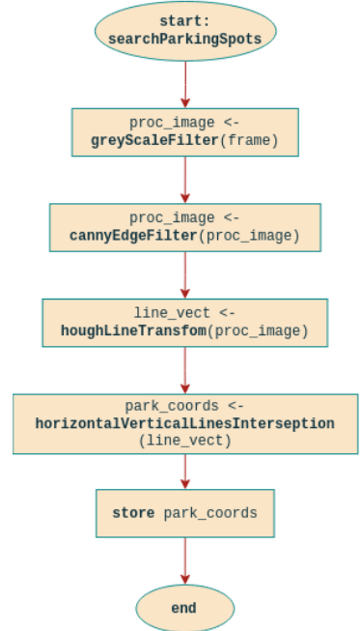
Camera - Flowcharts

Slide 22
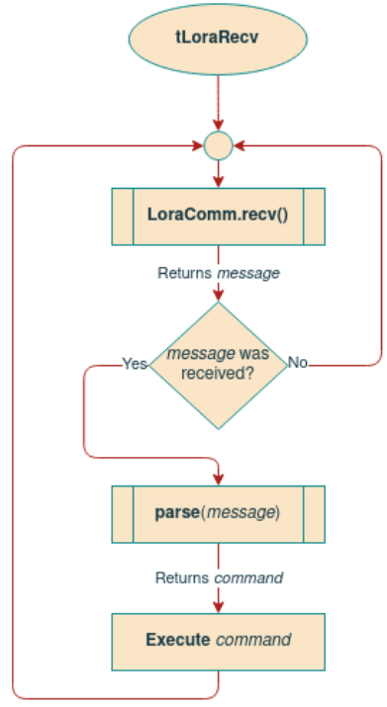
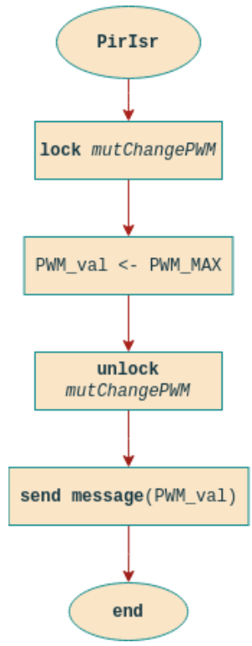
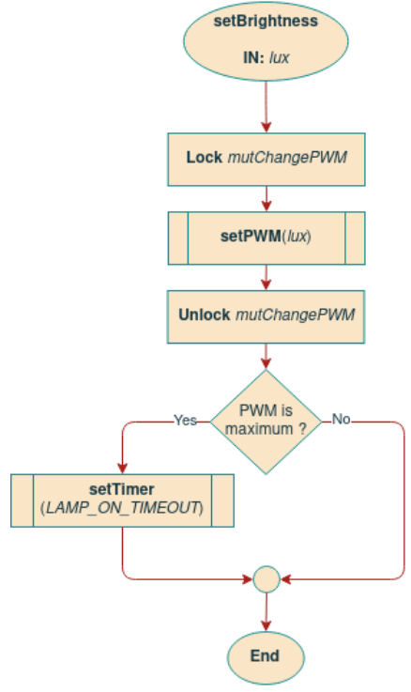
MainProcess - Flowcharts

Slide 23
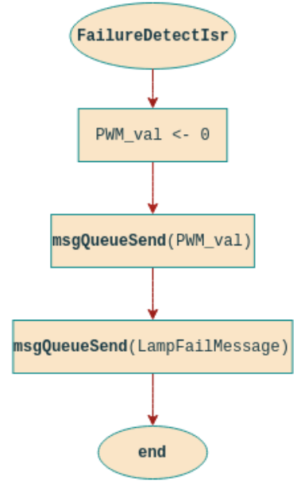
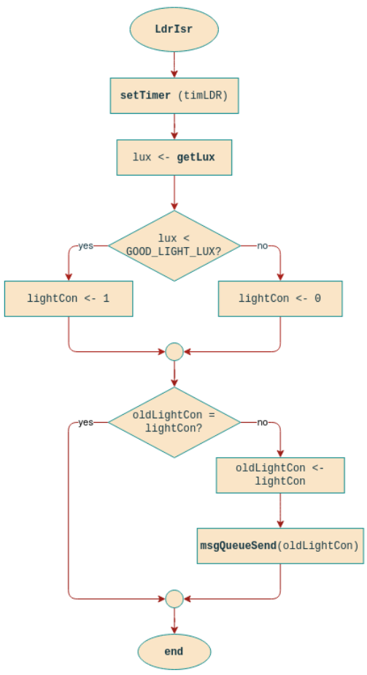
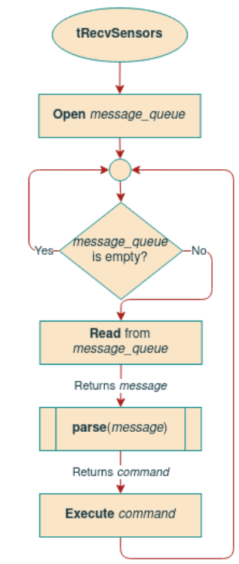
dSensors - Flowcharts

Slide 24
Software Specification
Gateway

Slide 25
Task Overview
tLoraRecv: receives all messages from local systems, using LoRa communication;
tTCPRecv: receives all messages from the remote server, using TCP-IP communication;
LoraComm::tSend: sends all received messages from the remote server to the local systems, using LoRa communication;
TCPclient::tSend: sends all received messages from local systems to the remote server, using TCP-IP communication;

Slide 26
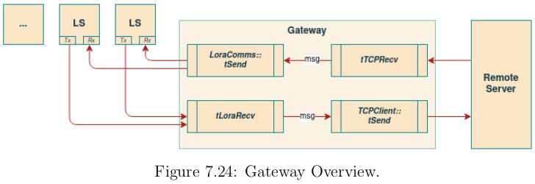
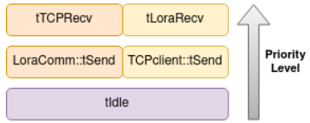
Task Overview

Slide 27
Task Synchronization
LoraComm::condSend
TCPclient::condSend
LoraComm::mutComm
LoraComm::mutSend
TCPclient::mutComm
TCPclient::mutSend

Slide 28
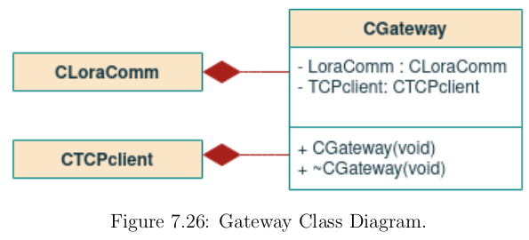
Class Diagrams

Slide 29
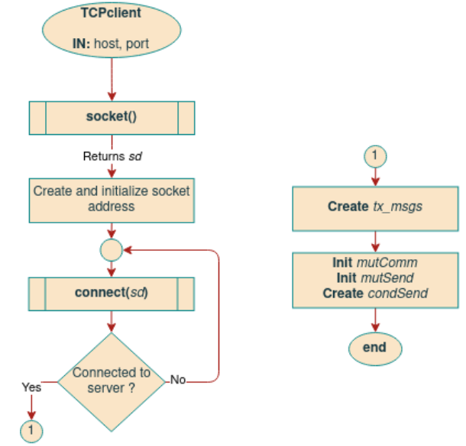
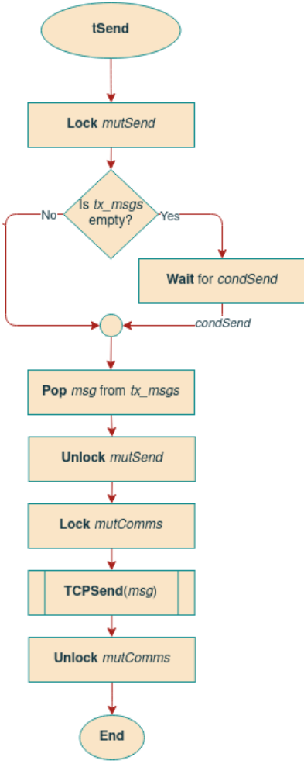
TCPclient - Flowchart

Slide 30
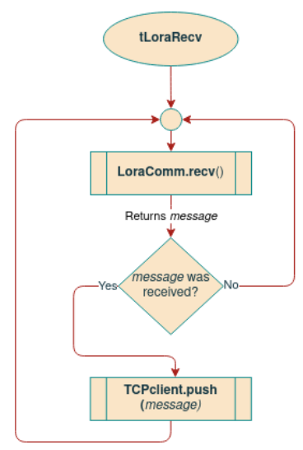

MainProcess - Flowchart

Slide 31
Software Specification
Remote System

Slide 32


Task Overview
tSend: sends all messages from the remote system to the clients, that can be a gateway, a mobile application or a web site; executes in the daemon.
tRecv: receive messages from the clients in order to process and execute them over a database.

Slide 33

Class Diagrams

Slide 34

Database

Slide 35

MainProcess - Flowcharts

Slide 36

MainProcess - Flowcharts

Slide 37

dServerSend - Flowcharts

Slide 38
Remote Clients Layout

Slide 39


Mobile App Layout

Slide 40


WebSite Layout

Slide 41
Software Tools
Buildroot: Tool to configure and generate the Raspberry Pi Kernel image;
C/C++: Programming language used to develop local system and remote system core;
Qt Creator: Cross-platform IDE used for the Mobile Application development;
HTML: Programming language chosen for the WebSite development;
Python: Programming language chosen for the Haar cascade training stage;
MySQL: Relational database management system used for the remote server database;

Slide 42
Software COTS
POSIX Threads API: Used for thread creation and management;
OpenCV API: Used for image capture and processing;
Qt API: Used for the GUI;
RaspiCam API: C++ API for using Raspberry camera with/without OpenCv;
Google Cloud SQL: Google Cloud service that allows for immutable data storage and retrieval;

Slide 43
Third-Party Libraries
Light Sensor (TSL258x) Device Driver: Open-source device driver used for interfacing with the luminosity sensor;
(https://github.com/torvalds/linux/blob/master/drivers/iio/light/tsl2583.c)
LoRa SX1278 Library: An Arduino open-source library for sending and receiving data using LoRa radios. This is implemented to the Arduino board, but it will be adapted to the Raspberry Pi 4 Model B. (https://github.com/sandeepmistry/arduino-LoRa)

Slide 44
Questions?

